Slide 1


Slide 2
Spread Spectrum Technology
In a conventional transmission system, the information is modulated with a carrier signal and then transmitted through a medium.
When transmitted, all the power of the signal is transmitted centered around a particular frequency. This frequency represents a specific channel and generally has a very narrow band.
In spread-spectrum we spread the transmission power over the complete band as shown in figure on the next slide.

Slide 3
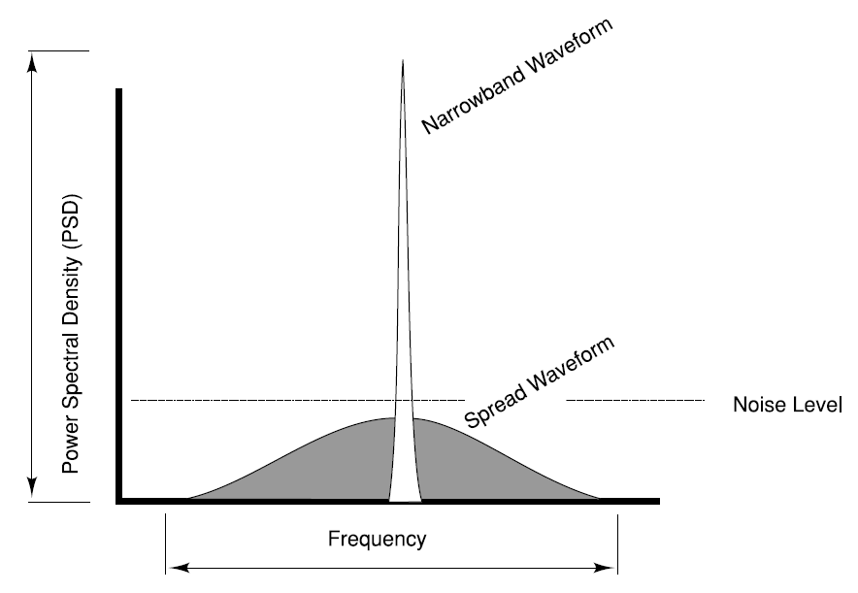
Spread Spectrum Technology

Slide 4
Spread Spectrum Technology
In spread-spectrum the transmission signal bandwidth is much higher than the information bandwidth.
There are numerous ways to cause a carrier to spread; however, all spread-spectrum systems can be viewed as two steps modulation processes.
First, the data to be transmitted is modulated.
Second, the carrier is modulated by the spreading code, causing it to spread out over a large bandwidth.

Slide 5
Different Spreading Techniques
Direct Sequence (DS): DS spread spectrum is typically used to transmit digital information. A common practice in DS systems is to mix the digital information stream with a pseudo random code.
Frequency Hopping (FH): Frequency hopping is a form of spreading in which the center frequency of a conventional carrier is altered many times within a fixed time period (like one second) in accordance with a pseudo-random list of channels.

Slide 6
Direct Sequence Spread Spectrum (DSSS)
Direct Sequence Spread Spectrum (DSSS) is often compared to a party, where many pairs are conversing, each in a different language.
Each pair understands only one language and therefore, concentrates on his or her own conversation, ignoring the rest. A Hindi-speaking couple just homes on to Hindi, rejecting everything else as noise.
Its analogous to DSSS is when pairs spread over the room conversing simultaneously, each pair in a different language. The key to DSSS is to be able to extract the desired signal while rejecting everything else as random noise.
The analogy may not be exact, because a roomful of people all talking at once soon becomes very loud.

Slide 7
Direct Sequence Spread Spectrum (DSSS)
In general, Spread-Spectrum communications is distinguished by three key elements:
The signal occupies a bandwidth much larger than what is necessary to send the information.
2. The bandwidth is spread by means of a code, which is independent of the data.
3. The receiver synchronizes to the code to recover the data. The use of an independent code and synchronous reception allows multiple users to access the same frequency band at the same time.

Slide 8
Direct Sequence Spread Spectrum (DSSS)
In order to protect the signal, the code used is pseudo-random, which makes it appear random while being actually deterministic, which enables the receivers to reconstruct the code for synchronous detection. This pseudo-random code is also called pseudo-noise (PN).
DSSS allows each station to transmit over the entire frequency all the time. DSSS also relaxes the assumption that colliding frames are totally garbled. Instead, it assumes that multiple signals add linearly.

Slide 9
Direct Sequence Spread Spectrum (DSSS)
DSSS is commonly called Code Division Multiple Access or CDMA in short.
Each station is assigned a unique m-bit code. This code is called the CDMA chip sequence. To transmit a 1 bit, the transmitting station sends its chip sequence, whereas to send 0, it sends the complement chip sequence.
Thus, if station A is assigned the chip sequence 00011011, it sends bit 1 by sending 00011011 and bit 0 by sending 11100100.
Using bipolar notations, we define bit 0 as -1 and bit 1 as +1. The bit 0 for station A will now become (–1, –1, –1, +1, +1, –1, +1, +1) and 1 becomes (+1, +1, +1, –1, –1, +1, –1, –1). The figure on the next slide depicts this with 6 chips/bit (011010).

Slide 10
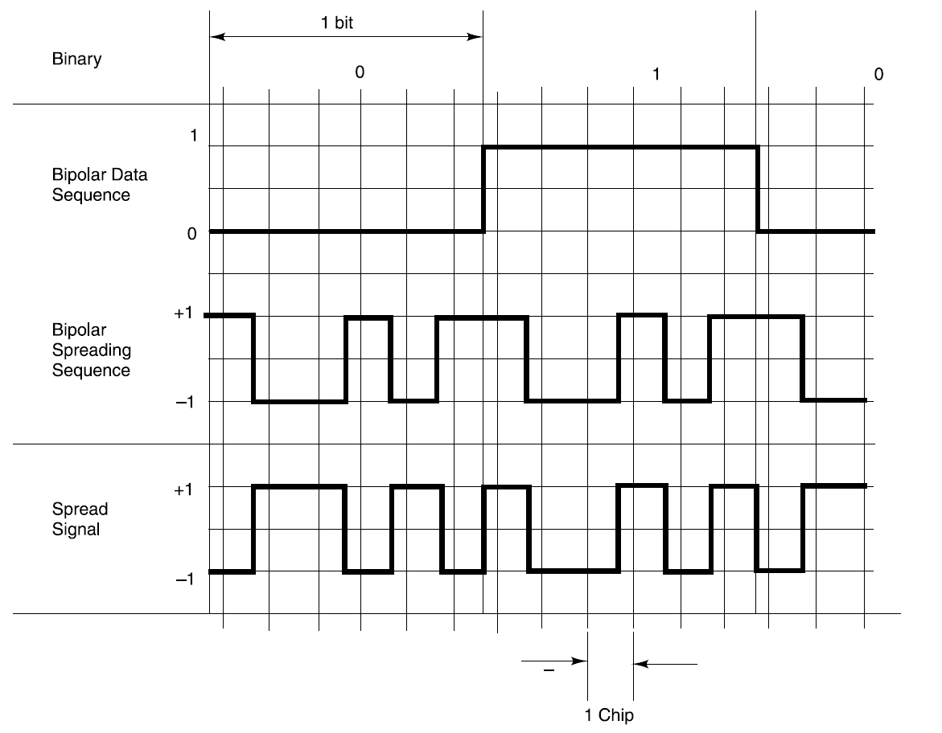

Direct Sequence Spread Spectrum (DSSS)

Slide 11
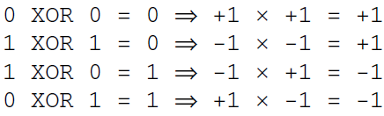
Direct Sequence Spread Spectrum (DSSS)
For manipulation of bits, we XOR (addition with modulo 2) the input bits, in bipolar notations we multiply to get the desired result:

Slide 12
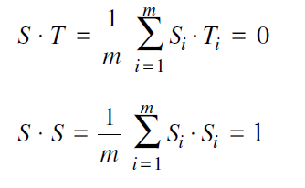
Direct Sequence Spread Spectrum (DSSS)
Each station has its unique chip sequence. Let us use the symbol S to indicate the m-chip vector for station S, and Sˉ is for its negation. All chip sequences are pair-wise orthogonal, by which we mean that the normalized inner product of any two distinct chip sequences, S and T (written as S·T ) is 0. In mathematical terms,

Slide 13
Direct Sequence Spread Spectrum (DSSS)
This orthogonality property is very crucial for mobile communication. Note that if S.T = 0 then S·Tˉ is also 0. The normalized inner product of any chip sequence with itself is 1. This follows because each of the m terms in the inner product is 1, so the sum is m. Also note that S·Sˉ = –1.
When two or more stations transmit simultaneously, their bipolar signals add linearly. For example, if in one chip period three stations output +1 and one station outputs –1, the result is +2.
To recover the bit stream of any station, the receiver must know that station’s chip sequences in advance.

Slide 14
Direct Sequence Spread Spectrum (DSSS)
DSSS does the recovery by computing the normalized inner product of the received chip sequence (the linear sum of all the stations that transmitted) and the chip sequence of the station whose bit stream it is trying to recover.
The CDMA orthogonal codes are generated through Walsh function. Walsh functions are generated by code-word rows of special square matrices called Hadamard Matrices. These matrices contain one row of all 0s, with the remaining rows having an equal number of 1s and 0s. Walsh function can be constructed for block length N = 2^{j}, where j is an integer. The TIA IS-95 CDMA system uses a set of 64 orthogonal functions generated by using Walsh functions. The modulated symbols are numbered from 0 through 63.

Slide 15
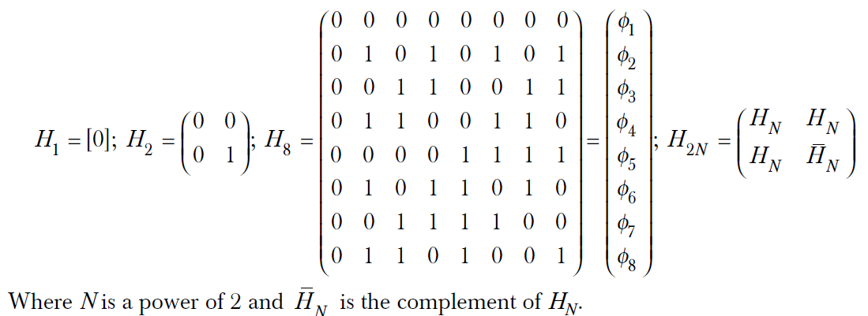
DSSS – Walsh Functions
The 64 X 64 matrix can be generated by using the following recursive procedure:

Slide 16
DSSS – Walsh Functions
The period of time required to transmit a single modulation symbol is called a Walsh symbol interval and is equal to 1/4800 seconds (203.33 μs). The period of time associated with 1/64 of the modulation symbol is referred as a Walsh chip and is equal to 1/307,200 seconds (3.255 μs). Within a Walsh symbol, Walsh chips are transmitted in the order 0, 1, 2, … 63.
For the forward channel (base station to mobile station), Walsh functions are used to eliminate multiple access interference among users within the same cell.

Slide 17
DSSS – Walsh Functions
In IS-95 or cdmaOne system different techniques are used for forward channel (BS to MS (Mobile Station)) and reverse channel (MS to BS) encoding.
cdmaOne is the brand name of the service introduced by Qualcomm for digital mobile communication. The same technology was adopted by TIA (Telecommunication Industry Association) as IS-95 standard for second generation digital mobile communication in the US.
Channelization in the forward link is accomplished through the use of orthogonal Walsh codes, while channelization in the reverse link is achieved using temporal offsets of the spreading sequence.

Slide 18
DSSS – BPSK and QPSK
The simplest form of a DSSS communications system employs coherent Binary Phase Shift Keying (BPSK) for both the data modulation and spreading modulation.
But the most common form of DSSS uses BPSK for data modulation and QPSK (Quadrature Phase Shift Keyed) modulation for spreading modulation.
QPSK modulation can be viewed as two independent BPSK modulations with 180 degree phase difference.
The figure on the next slide depicts an example of
QPSK for a bit stream 00111000.

Slide 19
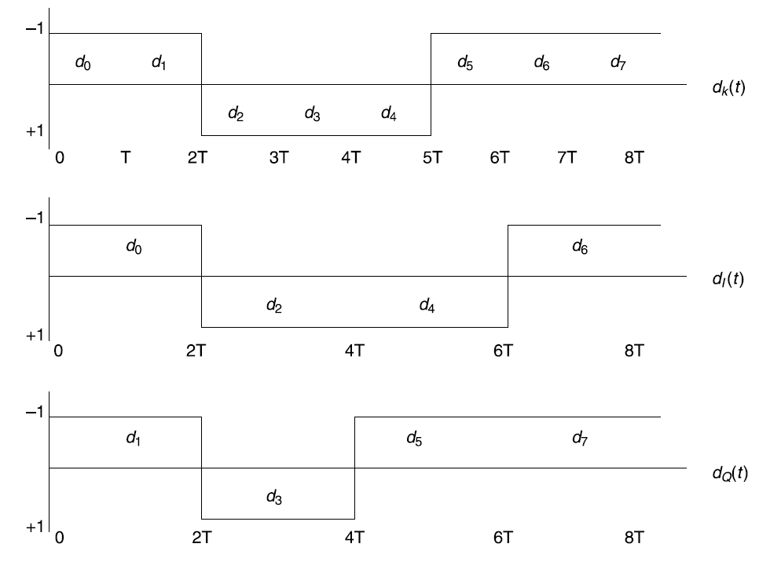
DSSS – BPSK and QPSK

Slide 20
IS-95
Telecommunications Industry Association (TIA) developed the IS-95 standard. This standard formed the basis for the first CDMA systems deployed in the cellular band (from 800 to 900 MHz) in North America.
This development eventually led to the TIA working with the T1P1 to develop the J-STD-008 standard for the PCS band (from 1800 to 1900 MHz). Since then, there has been some effort to enhance symmetric data rates for IS-95, resulting in the formation of a new standard in 1998, IS-95-B.
The IS-95 family of standards is known as cdmaOne. It is a second generation digital mobile communication system.

Slide 21
IS-95 – Speech and Channel Coding
The normal audio range of human beings is between 20 Hz to 20 KHz. However, this range is normally used for high fidelity CD quality music.
For telephonic communications where generally human voice is used, the frequency range of 300 to 3300 Hz is sufficient. For digitizing the speech, it is sufficient to sample at 8000 samples per second (assuming information bandwidth up to 4000 Hz).
Therefore, to achieve telephone quality speech, 12 bits are sufficient to encode each sample.
By using logarithmic sampling system 12 bits can be reduced to 8 bits per sample. This results in the PCM encoding of the speech and digitization of the voice at 64 Kbps. This digitized voice is then passed through a coding scheme using Code-Excited Linear Prediction (CELP) algorithm.

Slide 22
IS-95 – Speech and Channel Coding
Linear Prediction Coding (LPC) is a combination of waveform coding and vocoder. Vocoder emulates the human vocal cord functions electronically and generates synthesized voice. In this process the analog voice is converted into 9.6 Kbps digitized data.
In a mobile telecommunication environment, signal strength varies with location and movement of the mobile transmitter/receiver. Signal strength influences error rates, which in turn affects the quality of communication.
Due to varying signal strengths, mobile telecommunication systems are susceptible to burst errors. Burst errors are groupings of errors in adjacent bits as compared to errors that are dispersed over the whole data block. IS-95 addresses the problem of burst errors by utilizing an error correction scheme based on encoding and interleaving.

Slide 23
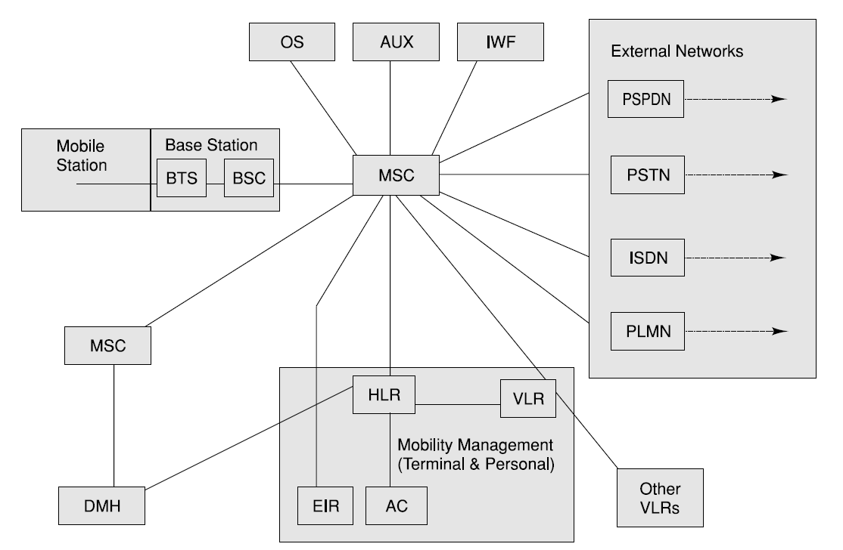
IS-95 Architecture

Slide 24
IS-95 Architecture
Different network entities within IS-95 are very similar to the network elements within a GSM network.
cdmaOne or IS-95 uses CDMA for its radio or last mile communication. Other than the radio interface, the rest of the network and especially the core are very similar to GSM.
The main network elements are:
Mobile Station (MS) : This is the mobile phone unit with the user. The MS terminates the radio path on the user side and enables the user to gain access to services from the network.

Slide 25
IS-95 Architecture
Base Station (BS) : The BS terminates the radio path and connects to the mobile switching center (MSC). BS is a system between the MS and the MSC. The BS is segmented into the BTS and BSC.
  Base Transceiver Station (BTS) consists of one or more transceivers placed at a single location and terminates the radio path on the network side.
  Base Station Controller (BSC) is the control and management system for one or more BTSs. The BSC exchanges messages with both the BTS and the MSC.
Mobile Switching Center (MSC): This is the main switching center equivalent to the telephone exchange in a fixed network. The MSC is an automatic system that interfaces the user traffic from the wireless network with the wireline network or other wireless networks.

Slide 26
IS-95 Architecture
Home Location Register (HLR) : HLR is the functional unit that manages mobile subscribers by maintaining all subscriber-related information. The HLR may be collocated with an MSC as an integral part of the MSC or may be independent of the MSC. One HLR can serve multiple MSCs or an HLR may be distributed over multiple locations.
Data Message Handler (DMH) : The DMH is responsible for collating the billing data.
Visited Location Register (VLR) : VLR is linked to one or more MSCs and is the functional unit that dynamically stores subscriber information obtained from the subscriber’s HLR data. When a roaming MS enters a new service area covered by the MSC, the MSC informs the associated VLR about the MS by querying the HLR after the MS goes through a registration procedure.

Slide 27
IS-95 Architecture
Authentication Center (AC) : The AC manages the authentication associated with individual subscriber. The AC may be located within an HLR or MSC or may be located independent of both.
Equipment Identity Register (EIR) : The EIR provides information about the mobile device for record purposes. The EIR may be located with the MSC or may be located independent of it.
Operations System (OS) : The OS is responsible for overall management of the wireless network.
Interworking Function (IWF) : The IWF enables the MSC to communicate with other networks.
External Networks : These are other external communication networks.

Slide 28
IS-95 Channel Structure
IS-95 system operates on the same frequency band as the first generation AMPS (Advanced Mobile Phone System). It uses Frequency Division Duplex (FDD) with 25 MHz in each direction.
It uses 824 to 849 MHz for forward link (base station to mobile station) and 869 to 894 MHz for reverse link (mobile station to base station). In digital communication, one data path maps on to one communication channel.
In CDMA a channel is defined in terms of a code sequence and frequency. This results in offering a higher channel capacity, which translates into an overall higher bandwidth.

Slide 29
IS-95 Channel Structure
IS-95 uses a different modulation and spreading technique for forward link and reverse link.
In forward link, 64 Walsh codes are used to map 64 logical channels. On the reverse link, channels are identified by long PN sequence.
For forward channels, base stations transmit information in four logical channel formats: pilot channels, sync channels, paging channels and traffic channels.
The reverse channel is organized in access and traffic channels.

Slide 30
IS-95 Call Processing
To set up a call or to transmit data, a data path needs to be established through a traffic channel. To establish a traffic channel, a mobile station in IS-95 goes through several states. They are:
System initialization
System idle state
System access
Traffic channel state

Slide 31
IS-95 Call Processing – CDMA Registration
The registration process is used by the mobile device to notify its location, status, identification and other characteristics.
Location information is required to page the mobile for an incoming mobile terminated call.
When the MS does power on or power off it goes through the registration process as well. These functions are similar to GSM.
Registration information is stored in HLR.

Slide 32
IS-95 – Authentication and Security
The Electronic Serial Number (ESN) of a IS-95 mobile station is a 32 bits binary number that identifies the mobile. It is factory-set and is not alterable in the field.
All mobiles are assigned a unique ESN when manufactured. A mobile station also has a unique 15-digit number called Mobile Identification Number (MIN). This is the mobile’s 10 digit directory number similar to the MSISDN number in GSM.
The difference is that in IS-95, the mobile is assigned a number similar to the North American numbering scheme.

Slide 33
IS-95 – Authentication and Security
Whenever a mobile is turned on, it registers with the network. During the authentication process the network throws a global challenge to the mobile.
The AC (Authentication Center) transmits a random number to the mobile station. The mobile station encrypts it using a key shared between the mobile station and the AC. The encrypted random message is sent back to the network. The AC checks this result with the result it calculates using the same random number and shared key.
If these match, the mobile is authenticated.
In IS-95, authentications even take place following successful handoffs. Following successful authentication, the VLR assigns a TMSI (Temporary International Mobile Subscriber Identity).

Slide 34
IS-95 – Authentication and Security
The TMSI provides anonymity since it is a transient identity only the mobile and the network are aware of.
The spreading PN (Pseudorandom Noise) sequence also play a role in security.
For anybody to impersonate the CDMA traffic, the eavesdropper needs to know the PN sequence.

Slide 35
IS-95 – Handoff and Roaming
A handover in GSM is called a handoff in IS-95. When a subscriber moves away from a base station, the signal power reduces resulting in a potential drop in connection.
To ensure that the call does not break, some other base station closer to the mobile station needs to attach the mobile to it and let the call continue without any interruption.
In CDMA, the spectrum is spread and everybody gets the same signal. Logically a mobile station in CDMA is always connected to different base stations at the same time. Therefore, handoff is managed by changing the attachment. There are three types of handoffs in CDMA. These are Soft handoff, Hard handoff, and Softer handoff.

Slide 36
IS-95 – Handoff and Roaming
In CDMA a cell is divided into sectors. Like in GSM it is normally divide into three sectors each covering 120°.
CDMA antennas are either Switched Beam System (SBS) or an Adaptive Antenna System (AAS).
The SBS uses multiple fixed beams in a sector and a switch to select the best beam to receive a signal.
In an AAS, the receiving signals by multiple antennas are weighted and combined to maximize the signal to noise ratio (SNR).

Slide 37
IS-95 – Handoff and Roaming
Soft Handoff
Soft handoff is a process in which the control of a mobile station is assigned to an adjacent cell or an adjacent sector (in the same frequency) without dropping the original radio link.
The mobile keeps two radio links during the soft handoff process. Once the new communication link is well established, the original link is dropped. This process is also known as “make before break”, which guarantees no loss of voice during handoff.

Slide 38
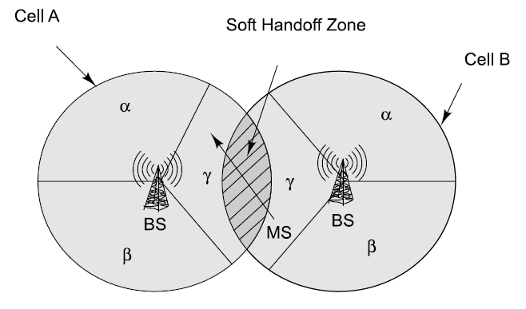
IS-95 – Handoff and Roaming

Slide 39
IS-95 – Handoff and Roaming
Hard Handoff
CDMA to CDMA hard handoff is the process in which a mobile is directed to handoff to a different frequency assigned to an adjacent cell or a sector.
The mobile drops the original link before establishing the new link. This is similar to a GSM handover. The voice is muted momentarily during this process. This handoff is completed very fast and cannot be noticed.

Slide 40
IS-95 – Handoff and Roaming
Softer Handoff : A mobile communicates with two sectors of the same cell (figure on the next slide). A rake receiver at the base station combines the best version of the voice frame from the diversity antennas of the two sectors into a single traffic frame. This is a logical handoff where signals from multiple sectors are combined instead of switching from one sector to another.

Slide 41
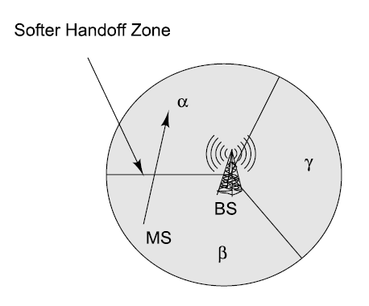
IS-95 – Handoff and Roaming

Slide 42
IS-95 Channel Capacity
The capacity of CDMA has a soft limit in the sense that we can add one additional user and tolerate a slight degradation of the signal quality. This is similar to a room full of people. Let us assume that people are talking to each other using a loudspeaker.
In such a case not many people will get a chance to talk or to listen. However, more people can talk to each other if they converse in low voices.
Another conclusion that can be drawn from this fact is that, any reduction in the multiple access interference converts directly and linearly into an increase in the capacity.
The capacity of a CDMA system depends on the following criteria: Voice Activity Detection (VAD), sectorization for capacity and frequency reuse considerations.
As a rule of thumb, the CDMA capacity is about four times that of TDMA and eight times that of FDMA.

Slide 43
CDMA versus 3G
GSM is a relatively mature technology, now several years in existence with a huge installation base.
GSM has many experienced operators and equipment manufacturers. Interoperability within GSM is well proven.
GSM is complete, open and has proven standards. GSM includes all the specifications from the handset other over the air, switch, interconnect it with switching, and every-aspect of mobile telecommunication.
On the other hand, IS-95 is mainly a single vendor (Qualcomm cdmaOne) specification. IS-95 only covers the air interface making it incomplete.
Though there are many claims and counter claims, it is generally believed that CDMA has high potential to address some of the difficult challenges of the past quite effectively.

Slide 44
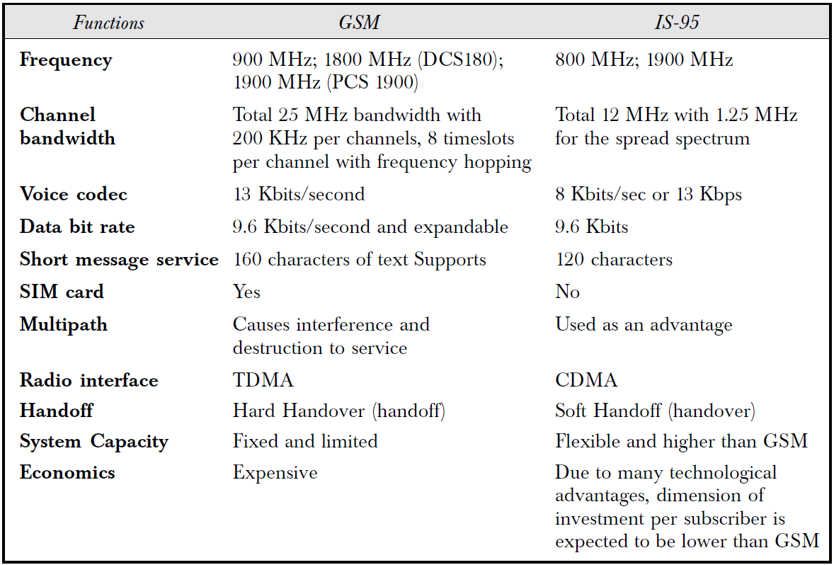
CDMA versus 3G

Slide 45
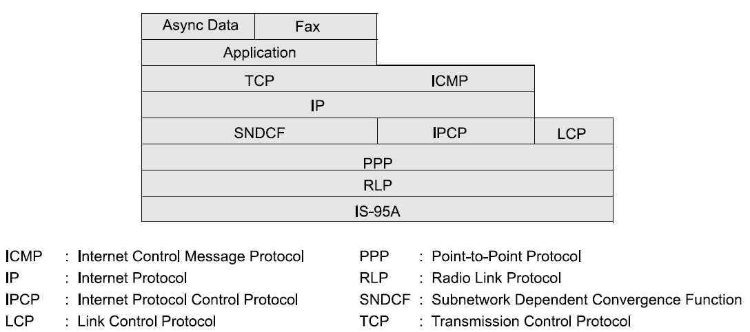
Wireless Data - CDMA stack

Slide 46
Wireless Data - CDMA stack
Application Interface Layer: This layer includes an application interface between the data source in the mobile station and the transport layer. The application interface provides functions like modem control, AT (Attention) command processing, data compression, etc.
Transport Layer: The transport layer for CDMA asynchronous data and fax is based on TCP. TCP has been modified for IS-95.
Network Layer: The network layer for CDMA asynchronous data and fax services is based on IP. The standard IP protocol has been enhanced for IS-95.

Slide 47
Wireless Data - CDMA stack
Sub-network Dependent Convergence Function: The SNDCF performs header compression on the header of the transport and network layers. Negotiation of the parameters for header compression is carried out using IPCP (Internet Protocol Control Protocol).
The SNDCF sub-layer accepts the network layer datagram packets from the network layer, performs header compression and passes that datagram to the PPP (Point to Point Protocol) layer. In the reverse operation, it receives network layer data-grams with compressed header from the PPP layer and passes it to the network layer.

Slide 48
Wireless Data - CDMA stack
Data Link Layer: This layer uses PPP. The PPP Link Control Protocol (LCP) is used for initial link establishment and for the negotiation of optional link capabilities.
Internet Protocol Control Protocol Sub-layer: This sub-layer supports negotiation of the IP address and IP compression protocol parameters. In general, a mobile station does not have a permanent IP address. Therefore, the IP address needs to be negotiated and obtained from the network. IPCP does this job of leasing an IP address when the transport connection is established. The IP address is discarded when the connection is closed.

Slide 49
Wireless Data - CDMA stack
Radio Link Protocol Layer: This layer provides octet stream service over the air. This service is responsible for reducing the error rate over the forward and reverse channels. RLP frames may be transported as traffic or signaling via data burst message.

Slide 50
SMS in CDMA
SMS in IS-95 is similar to SMS in GSM. Unlike GSM, the maximum size of a SMS in IS-95 is 120 octets. The SMS in IS-95 work the same way as in GSM.
It supports SMPP protocol and other features as in GSM. Like in GSM, the SMS in IS-95 uses the signaling channel for data transfer.
SMS administration features include storage, profiling, verification of receipt and status enquiry capabilities.

Slide 51
Third Generation Networks
The 3G system will offer a plethora of telecommunication services including voice, multimedia, video and high speed data.
With 3G mobile Internet technology significant changes will be brought about in the day-to-day life of the people.
CDMA is the preferred approach for the third generation networks and systems. cdma2000 is the version of 3G. cdma2000 standards are being driven by Telecommunication Industries Association (TIA).
It uses the CDMA air interface, which is based on IS-95 and cdmaOne.

Slide 52
Third Generation Networks
In Japan, 3G standard uses (Wideband Code Division Multiple Access) WCDMA (DoCoMo) version.
In Europe, Asia, Australia and many parts of the world 3G has been accepted as UMTS and WCDMA. UMTS/WCDMA is being driven by ETSI, and is the normal evolution from GSM/GPRS.
The main goal of UMTS (Universal Mobile Telecommunications System) is to offer a much more attractive and richer set of services to the users like Universal Roaming, Higher Bit Rate, Mobile-Fixed Convergence and Flexible Service Architecture.

Slide 53
IMT – 2000
International Mobile Telecommunications-2000 (IMT-2000) is the global standard for third generation (3G) wireless communications, defined by a set of interdependent ITU Recommendations.
IMT-2000 will provide a framework for worldwide access of services by linking the diverse systems of terrestrial and/or satellite based networks through the synergy between digital mobile telecommunications technologies and systems for fixed and mobile wireless access systems.
IMT-2000 was, originally, envisioned to be launched in the year 2000 with a bandwidth of 2000Kbits/second (2Mbps).

Slide 54
IMT – 2000
It is also popularly known as 3G or 3rd Generation that includes EDGE, CDMA 2000, UMTS, DECT and WiMAX (which was added in 2007) standards. These standards are both evolutionary and revolutionary.
Various independently developed standards like DECT and WiMAX were included because they fit the IMT-2000 definition.
The services provisioned by IMT-2000 set of standards include wide area wireless voice telephone, video calls and wireless data for a mobile user.

Slide 55
CDMA 2000
cdma2000 is the third generation version of cdmaOne or IS-95. The cdma2000 Radio Transmission Technology (RTT) is a spread spectrum, wideband radio interface.
It uses CDMA technology as its underlying modulation technology. cdma2000 meets the specification for ITU (International Telecommunication Union) and IMT-2000.
It addresses the specification for indoor, indoor-to-outdoor, pedestrian and vehicular environment.
Two types of data services are currently under consideration for cdma2000. These are packet data and high speed circuit switched data. Packet data will be used for asymmetric bursty traffic like Internet browsing or mails. The circuit switched data can be used for delay sensitive real-time traffic.

Slide 56
UMTS/WCDMA
The standards body for 3G is called UMTS and 3GPP.
To avoid copyright issues, 3G in Europe and ARIB in Japan have devised a different flavor of CDMA called Wideband CDMA or WCDMA.
WCDMA is also known as UTRAN (UMTS Terrestrial Radio Access Network) FDD (Frequency Division Duplex).
The physical layer of UMTS and WCDMA uses direct sequence spread spectrum (DSSS) modulation .The channel bandwidth is 5 MHz and the data rates supported range from a few kb/s to 2 Mb/s.
The physical layer supports two modes of operation: FDD (Frequency Division Duplex) and TDD (Time Division Duplex).

Slide 57
Applications on 3G
Devices in 3G can work in multiple ways. They can run in a tunneling mode or in an application mode.
In tunneling mode, the device works more as a pass through device or a modem. In this mode, the mobile phone is connected to another device like a laptop and functions as a wireless media interface. The intelligence of the phone is not used, only the communication interface of the phone is used.
In an application mode, applications run on the phone itself. A 3G mobile phone will support, SMS, WAP, Java, etc. (MExE classmark 3). A MExE classmark 3 mobile device will have an
execution environment that will allow application development for the client device.

Slide 58
Applications on 3G
In 3G, there will be different types of client applications: Local, Occasionally connected, Online and Real-time.
Games, cartoons and similar applications are examples of local applications. These applications can be downloaded over the air and used offline.
In an occasionally connected computing (OCC) environment, the user will connect to the network occasionally. Downloading and uploading of emails are the best examples of OCC.
Online applications will be the corporate applications. Examples of such applications will be online order booking or updating of inventory status.
Real-time applications could be real-time stock updates or applications for law-enforcement agents for real-time tracking or navigational systems.

Slide 59
Applications on 3G
Some 3G specific applications are:
Virtual Home Environment (VHE) – Virtual Home Environment can be defined as a concept where an environment is created in a foreign network (or home network outside the home environment) so that the mobile users can experience the same computing experience as they have in their home or corporate computing environment while they are mobile and roaming.
Personal Communication Networks (PCN) – These are digital telephone networking infrastructures, which supports personal numbering, individual service selection, moves towards unified billing and call anytime, anywhere through wireless digital telephony.

Slide 60
Applications on 3G
Universal Subscriber Identity Module (USIM) – This is the smart card for third generation mobile phones. A SIM card in the mobile phone offers portability, security and individuality.
Audio/Video – Third generation applications will be used to download music, multimedia, news, etc.
VoIP
Electronic Agents – Electronic agents are defined as “mobile programs that go places in the network to carry out their owners’ instructions. They can be thought of as extensions of the people who dispatch them.”
Downloading of Software and Content
ENUM – ENUM is a protocol that is emerging from work of Internet Engineering Task Force’s (IETF’s) Telephone Number Mapping working group.

